Slide 1
Chapter 2: Society and Chemical Perspective

Slide 2
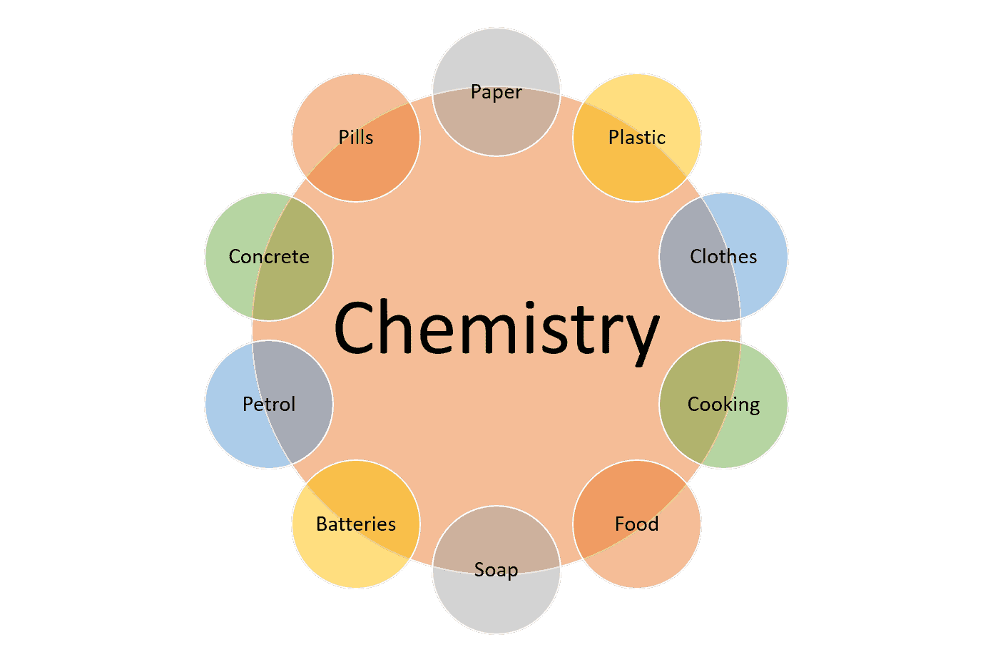
Importance of Chemistry in Society

Slide 3
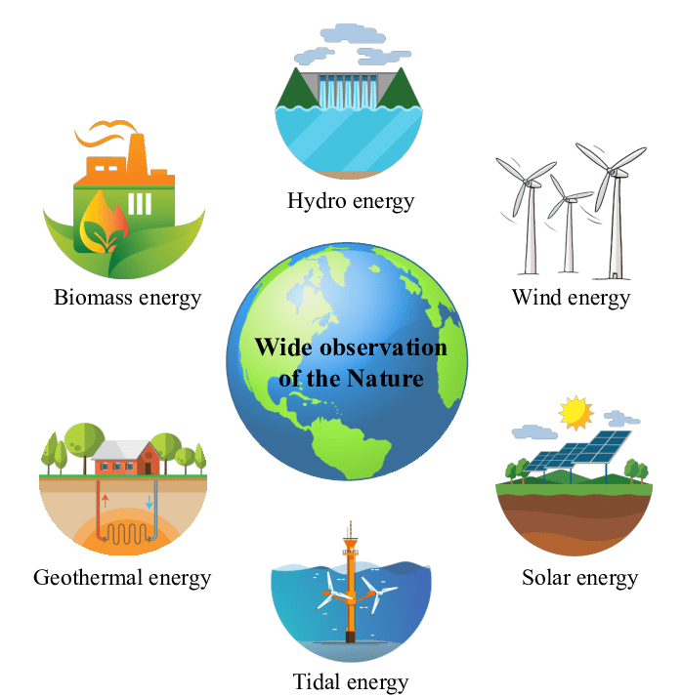
Energy from natural resources
Renewable Energy is derived from natural processes that are replenished constantly.

Slide 4
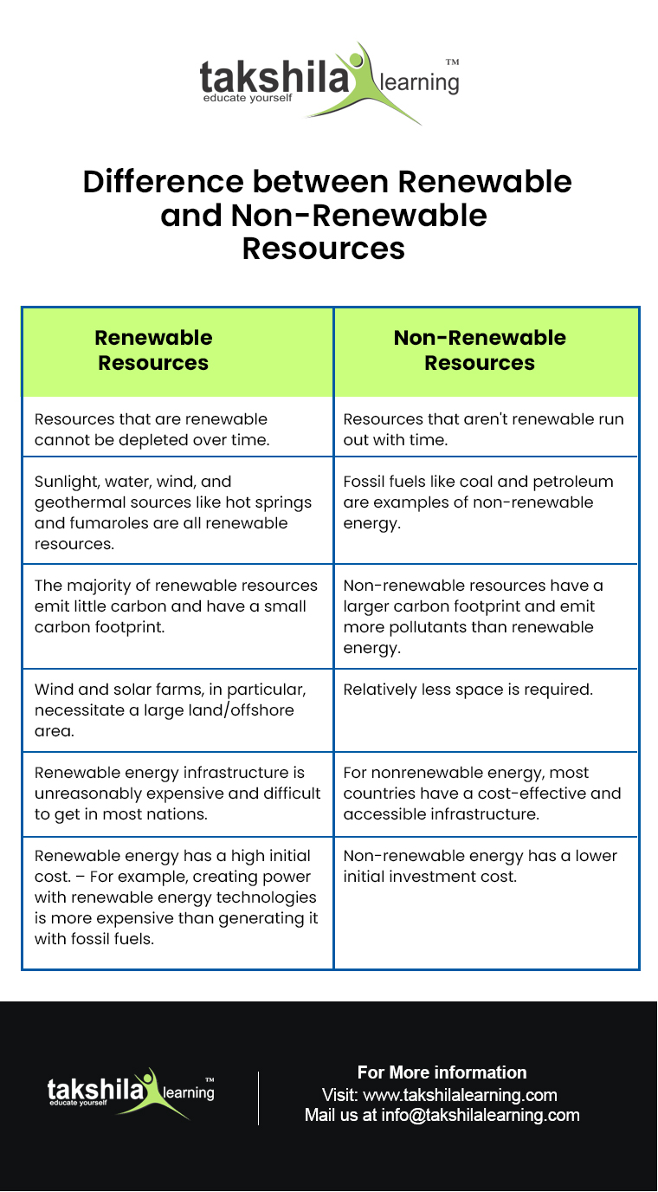

Slide 5
Solar Energy
Solar energy is radiant light and heat from the sun and is harnessed by using technologies such as solar heating, photovoltaics, solar thermal energy and artificial photosynthesis. These technologies convert sunlight into electrical energy either through photovoltaic (PV) panels or through mirrors that concentrate solar radiation. This energy can be used to generate electricity or be stored in batteries or thermal storage.

Slide 6
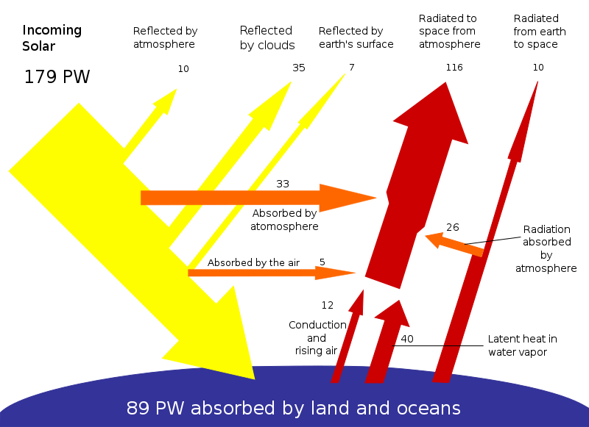
About half of the incoming solar energy reaches the earth surface

Slide 7
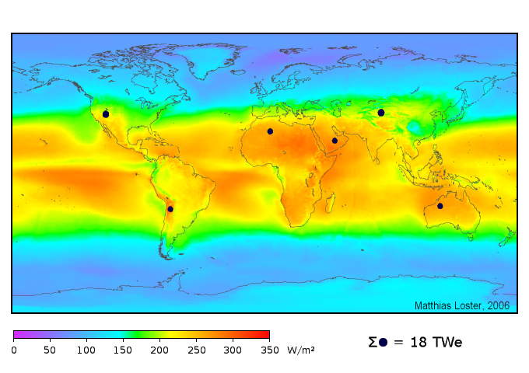
The theoretical area of the small black dots is sufficient to supply the world's total energy needs of 18 TW with solar power.

Slide 8
Advantages of Solar Energy
It is pollution free and causes no greenhouse gases to be emitted after installation.
Reduced dependence on foreign oil and fossil fuels
It is renewable clean power that is available everyday of the year, even cloudy days produce some power.
No maintenance is required, the solar panels last over 30 years.
It creates jobs and helps the economy.
Excess power can be sold back to the power company.
No special installation place is required.
It can be used to heat water, power homes, power cars.
It is safer than traditional electric current.

Slide 9
Disadvantages of Solar Energy
High initial costs for material and installation.
Needs lot of space.
Devices that run on DC power directly are more expensive.
Cloudy days do not produce much energy.
Not easily affordable.
Lower efficiency.
Lower production in winter months.

Slide 10
Uses of Solar Energy
In Water heaters.
Indoor lighting with solar energy.
Heating swimming pools with solar energy.
Cooking purposes as solar cookers.
In residential areas.
In industries.

Slide 11
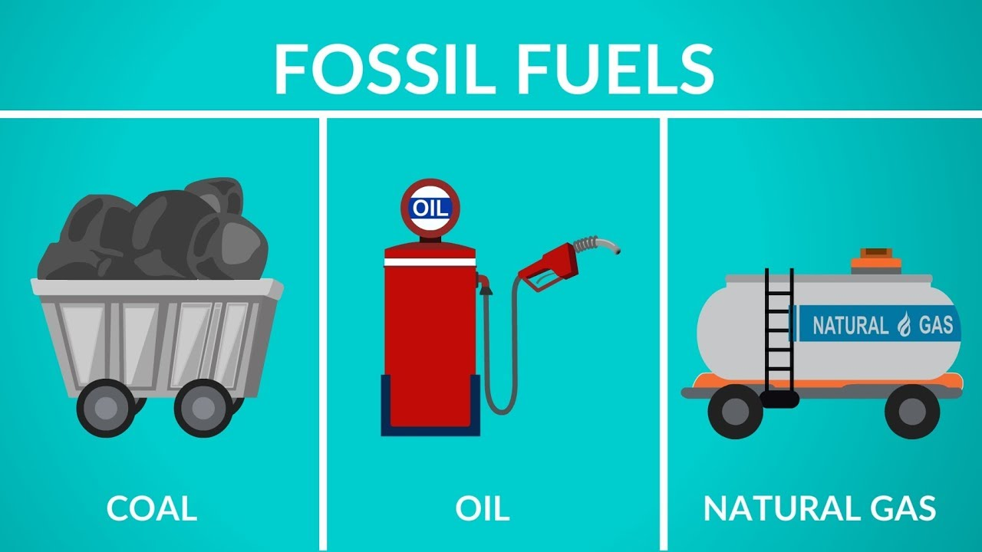
Energy from Fossil Fuels
Fossil fuel is a term used to describe a group of energy sources that were formed from ancient plants and organisms during the Carboniferous Period, approximately 286 – 360 million years ago.
As the organisms and plants died, they sank to the bottom of the swamps and oceans and formed layers of a spongy material called peat. Over millions of years, the peat was covered by sand, clay, and other minerals, which converted the peat into sedimentary rock. Over time, different types of fossil fuels formed.
There are three major types of fossil fuels:

Slide 12
Importance of Fossil Fuels
Easy availability
Production of large volume of power
Highly stable in all types of weather conditions and have high calorific value.
Easy to transport.
Cost effective.

Slide 13
Problems with fossil fuels
Environmental degradation due to pollution caused by them.
Finite and non-renewable source of energy.
High cost and high risk of spilling by the huge tankers carrying oil from one place to another.
Public health issues due to pollution caused by burning of fossil fuels.
Rising cost of the fossil fuels.
Need huge amount of reserves.

Slide 14
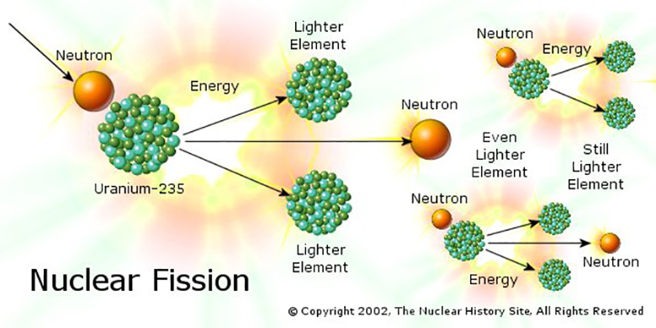
Energy from Nuclear Fission
The process of splitting of heavier nucleus into a number of fragments of a smaller mass by suitable bombardment with sub-atomin particles is called nuclear fission.

Slide 15
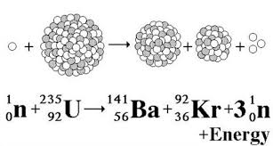
Cause of release of nuclear energy
The enormous amount of energy released during the nuclear fission is due to the loss in some mass when the fission reaction takes place. The loss in mass gets converted into energy. For e.g.

Slide 16
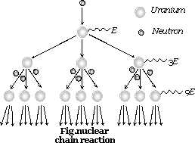
Nuclear Chain Reactions
A chain reaction refers to a process in which neutrons released in fission produce an additional fission in at least one further nucleus. This nucleus in turn produces neutrons, and the process repeats.

Slide 17
Types of Nuclear Fission Reactions
Uncontrolled Fission Reaction or explosive fission reaction: Atom Bomb
Controlled Fission Reaction: Nuclear Reactor

Slide 18
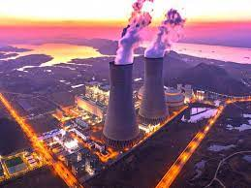
Nuclear Reactor
The arrangement or equipment used to carry out fission reaction under controlled conditions is called a nuclear reactor.

Slide 19
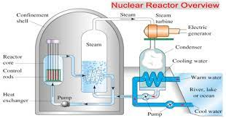
Components of Nuclear Reactor
Fuel rods
Controlling Rods
Moderator
Coolant
Protective Shield
Generation of Electricity

Slide 20
Breeder Reactor
A breeder reactor is a nuclear reactor that generates more fissile material than it consumes. Breeder reactors achieve this because their neutron economy is high enough to create more fissile fuel than they use, by irradiation of a fertile material, such as uranium-238 or thorium-232, that is loaded into the reactor along with fissile fuel.
Breeder reactors use highly enriched fuels, which pose the danger of critical accidents. They also work at a very high temperature and a fast pace. Plutonium persists for a long time in the environment, with a half-life of 24,000 years, and is highly toxic, causing lung cancer even if a small amount is inhaled.

Slide 21
Thank You

